Slide 1





Established Debaters
@goldcoastdebating
@goldcoastdebating
Goldcoastdebating.org
GCD Summer school 2023

Slide 2
The Established Debaters session will cover:
Higher Expectations in:
General Knowledge
Rebuttal
Economy of words
Models
Advanced techniques:
Hard/Soft Lines
Fundamental clashes
Benchmarks
POIs

Slide 3
Higher Expectations

Slide 4

Timing of Debates
Intermediate A Division
  7 minutes (30 secs either side = no penalty)
  Warning bell at 6 mins
  Do not speak for more than 7 min 30 sec
Open A & B Divisions
  8 minutes (30 secs either side = no penalty)
  Warning bell at 7 mins
  Do not speak for more than 8 min 30 sec
Do adjudicators simply ‘stop listening’ after 30 seconds over? No, it's not a hard and fast rule like that, but content presented then is not considered as favourably / weighted as heavily.

Slide 5
Higher Expectations- General Knowledge
At the senior level, students should also be gathering their information from a range of unbiased sources and presenting well-rounded perspectives on current affairs.
Critical, higher-order thinking should be starting to come to the fore in the higher divisions.

Slide 6
Greater Focus on the Arguments
By Intermediate A, teams are expected to have a grasp on manner and method.
That doesn't mean that these criteria are no longer relevant, but simply that as much focus as possible should be on the arguments.
Timing and manner become less important than who won the debate itself.

Slide 7
Economy of words – Established Debaters
Economy of words
Aspects of a speech that aren’t actual content (i.e. summaries, greetings, etc.) should use as few words as possible:
“Before I continue my teams case, I’d like to point out a number of contentions within the opposition’s arguments.”
“First, several points in rebuttal:”
“The opposition’s first speaker stated…”
“At First, we heard…”
First speaker’s first point = 1.1, etc.
E.g.
“At 1.1, we heard…” instead of, “The opposition’s first speaker said in their first point…”
Re-stating the topic at every speaker is unnecessary.
Formal greetings are unnecessary except at first AFF.
Summaries should use one or two words to signpost a point, e.g.:
“Our First spoke about job security and personal finances. I will…”

Slide 8
Higher Expectations – Rebuttal
In the senior divisions, students should be gaining proficiency in rebuttal strategies, structure and strength. There should be a greater percentage of speeches being spent on rebuttal, especially for third speakers (majority)
More advanced techniques, such as comparative rebuttal, should be being utilised.

Slide 9
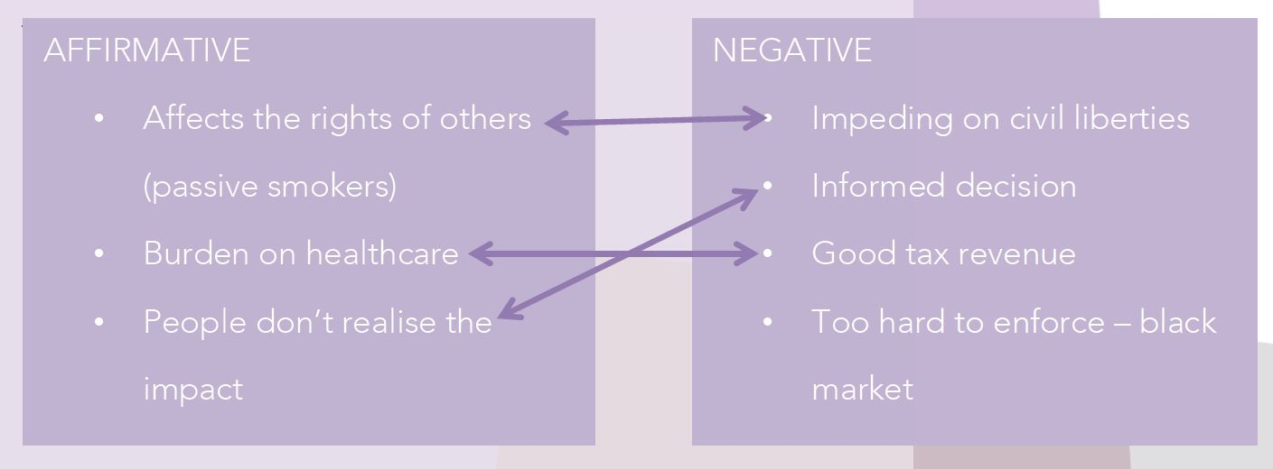
Rebuttal - Matter
There are higher expectations placed on debaters who aren’t juniors
The substantive (arguments) and rebuttal should be less segregated and more entwined – there should be constant referencing to arguments in rebuttal and vice-versa
You may see:
  case comparisons
  comparative rebuttal

Slide 10
Types of Rebuttal
Shopping List Rebuttal
Where the speaker takes individual points presented by the opposition and rebuts them individually
Comparative Rebuttal
Speakers take a point that the opposition has presented and use one of your points to directly refute it – hard but impressive
Whole Case Rebuttal
Where the takes their opposition’s case line or otherwise core argument and refutes it. Very powerful (aka case comparison)
Thematic / Issues-based Rebuttal
3rd speakers organise / categorise their rebuttal under key themes or issues

Slide 11
Other Advanced Techniques

Slide 12
Models and Counter-Models
Appearing mostly in “should” debates – which advocate change – teams need to outline what change they are advocating. How will the change be carried out?
  What are the details of the change? Its extent?
“University education should be free”
  For who? Only those who qualify?
  Who would pay for it? The government?
  How would this change be carried out? From when?
Teams don’t need to go into too much detail, just enough so we know exactly what it is that they’re trying to say should happen, so we don’t waste time debating over that instead of the real issues.
A model should be introduced by the first speaker after or as a part of their definition. If a team is advocating for a change then they must have a model or counter model.
Negative teams can have counter models (that can be the status quo)

Slide 13
Hard and Soft Lines
Usually come into play for negative teams.
They pertain to how strongly a negative team refutes the affirmative’s case.
Example
Topic: “Generation Z are lazy”
Soft negative: Generation Z are not lazy they just work differently, on
computers etc.
Hard negative: Generation Z are incredibly hard-working and possess
an impeccable work ethic in all facets of their rich lives.
The soft line is not always weaker. It usually is, but sometimes, as perhaps in this instance, it can be more effective.
Adjudicators – consider the spirit of the debate and whether it is being addressed

Slide 14
Fundamental Clash
Often refers to an underlying, political or ideological-based clash in the debate
Identifying these can help teams take a more well-rounded and sophisticated approach to the debate, as well as draw similarities to other examples/situations
Example
  Topic: Smoking should be banned
  The affirmative case argues for a conservative "good of society" standpoint, whilst the negative case comes from a more liberalist, "rights of the individual" perspective

Slide 15
Benchmarks
Help make debates and cases clearer
Included in the definition
Benchmarks should be used in “is” or “are” type debates – for example:
“We are the lucky country”
What constitutes lucky? Compared to what countries?
“We watch too much TV”
How much is too much?
“Advertising is harmful.”
What is this debate going to consider constitutes harmful?

Slide 16
Points of Information (POIs)
A question asked of a speaker during their speech
Each speaker in the debate is obligated to accept two POIs, and offer two POIs throughout the entire debate (not per speaker)
POIs cannot be offered in the first or last minute of a speech – there will be a bell 1 min into the speech and when there is 1 min left to go to assist with this
Purpose: to undercut the point the opposition is currently making, or to force the opposition to respond to a difficult question immediately

Slide 17
Points of Information
The purpose of a POI is to undercut the point the opposition is currently making
If can be used to force the opposition to respond to a difficult question on the spot
As an adjudicator, decide which was better: the question or the answer?
Did the question take more away from the speaker’s case than their response added?

Slide 18
Points of Information
The person asking the POI will stand and ask the speaker, “POI?”
The speaker should respond politely with “no, thank you” or “yes” or “yes, please”
  Any rude response or simple waving the speaker down impacts their Manner
The response should be directed to the audience, not the asker (Manner)
Once asked, the asker should sit down immediately (they should never argue back)
  It’s okay for you to wave them down if they forget
Too many POIs asked in succession is badgering

Slide 19
POI Examples
Good | Not Good
“You mentioned the decline in Indigenous languages. Can you explain the connection between Indigenous languages and the commodification of Indigenous culture?” POIs should catch the speaker off-guard by pointing out something that, as evidenced by what they’re saying, they have missed or are not prepared to respond to. If the question does so, the POI asker has been successful. | “Where did you get that information?” “[Insert rebuttal here] How do you respond?” Similar to rebuttal, debaters shouldn’t ask anything that nitpicks an insignificant details of what the speaker is saying. If the question helps the speaker reinforce a point or emphasise their case, then the POI asker has not been successful.

Slide 20
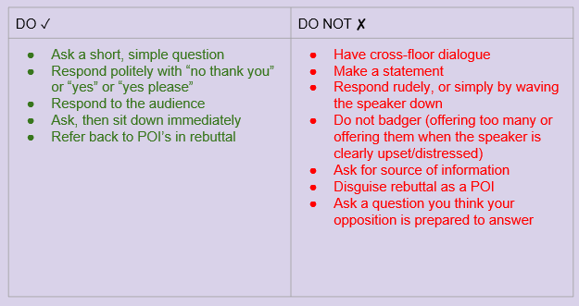
POI Do’s and Don’ts

Slide 21
Interrupting POIs – Adjudicators Only
As the adjudicator you can (and sometimes should) interrupt POIs
When | What to say
Offered in the first or late minute. | “Out of order, time.”
The asker forgets their question. | “It’s okay, have a seat.”
The asker keeps talking about their own point. | “Out of order, ask a single question.”
The speaker gets too flustered/freezes up. | “It’s okay, move on.”
Badgering. | “Out of order, badgering.”
Cross floor dialogue. | “Out of order, no cross floor debate.”
Personal attacks/inappropriate. | “I’ll ask the speaker to move on.”

Slide 22
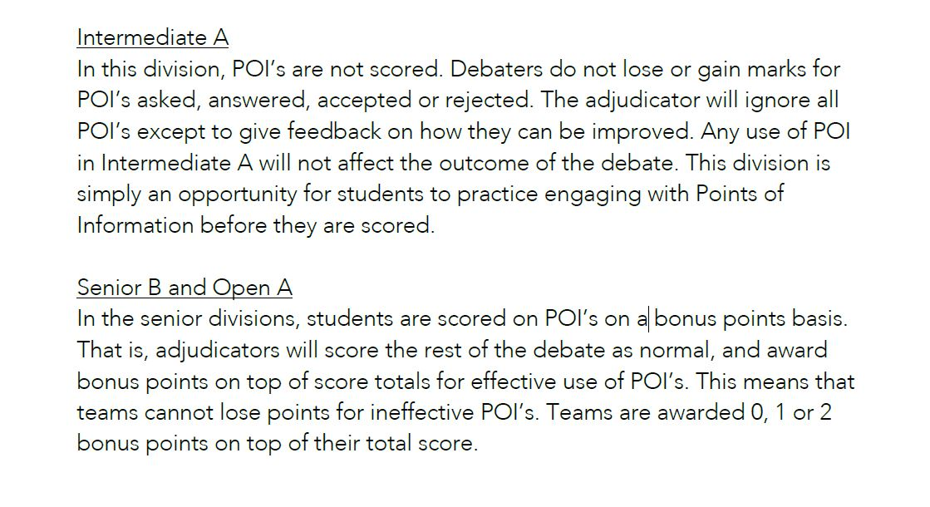
Scoring POIs

Slide 23
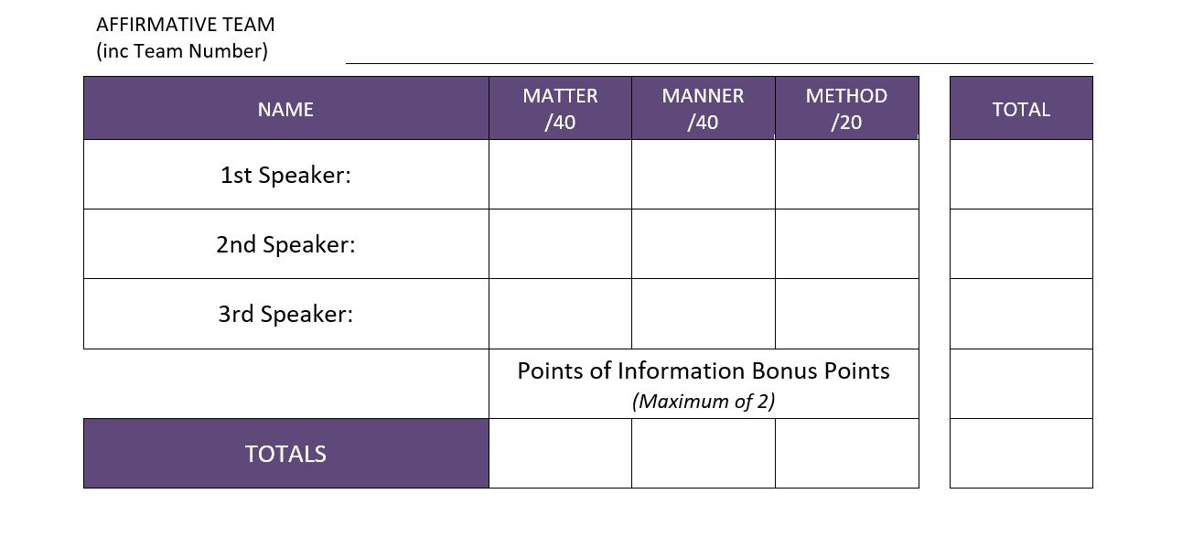
Scoring POIs

Slide 24
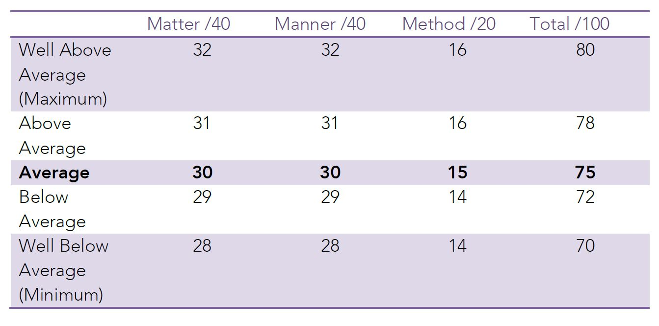
Scoring

Slide 25

No Draws
If the scores are tied once all criteria have been considered, make a change so that one team wins.
There are no draws. You need to award a win to one team.
Go with the team that ultimately won the argument. Who convinced you?

Slide 26
Scoring – tips for adjudicators
Give your Adjudicator’s score sheet to the Venue Coordinator at the end of the night.
You don’t need to tell the scores (teams or individual) to debaters
If you like, when delivering your adjudication (next slide), you can tell them that it was a close debate or even that it was awarded by one point.
If asked for scores, you are empowered to say, “I don’t give out scores.”
Debaters: you are scored based on how you do in comparison to the other speakers in that particular debate. As such, your scores may be wildly different between debates and are not a helpful metric for you to know.

Slide 27

How to deliver an adjudication
A couple of points of general feedback, especially if it applies to multiple debaters, can be given to the room. Then declare the winner and sit. The chairperson will then close the debate.
  Some adjudicators like to announce the winner first, then provide general feedback. This is okay too.
Avoid give individual feedback or single speakers out in front of the whole room
Give at least one (or more) positives to each speaker
Keep reasons for winning general, not specific to one argument or one speaker
Invite speakers to see you for individual feedback
  If you need to go, that’s okay. Just let the teams know that you aren’t able to stay for feedback.
Be mindful of coordinators and lock-up time

Slide 28
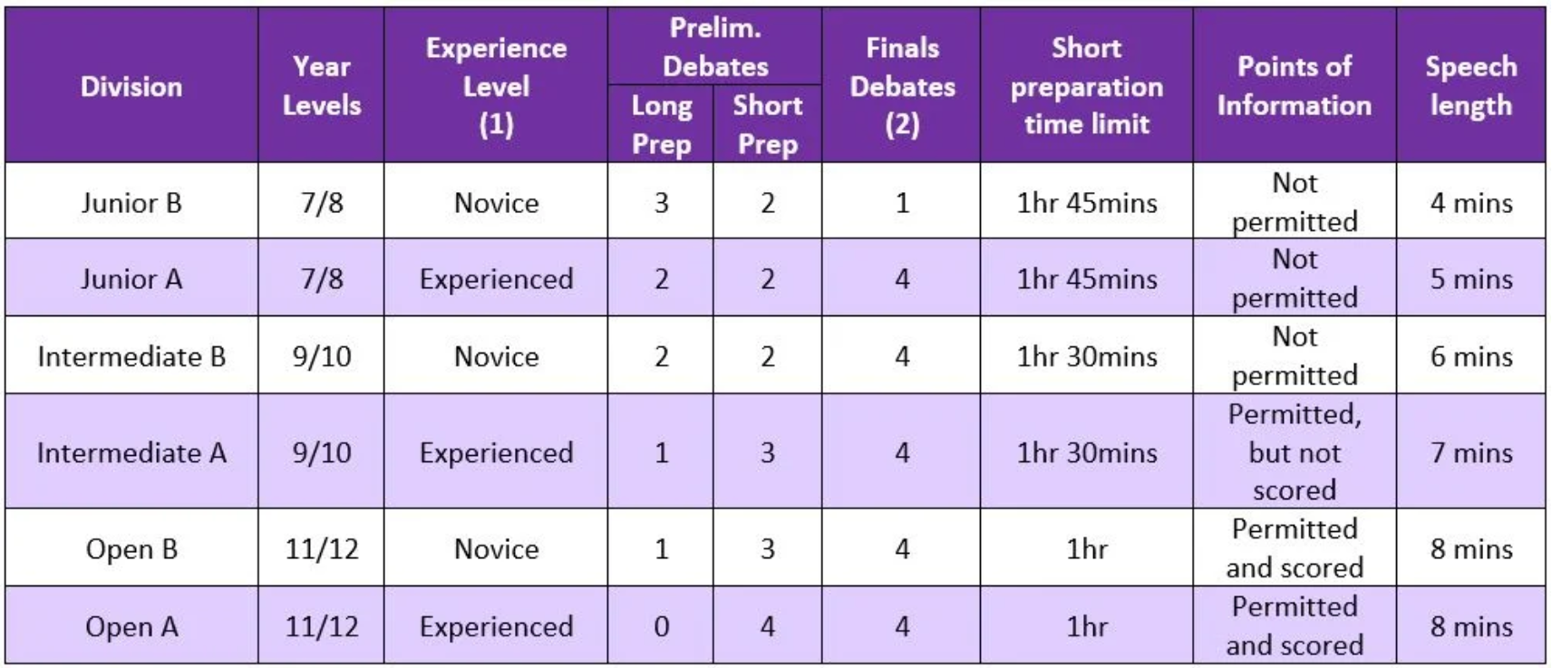

Slide 29
Questions?

Slide 30

Want to help us out?
We are looking to start some subcommittees for GCD. If you are a coach, teacher, adjudicator or alumni and interested in helping get more resources out to our community, please scan the QR code and fill out the form or come talk to one of the executive after the session :)

Slide 31
Kahoot!
https://play.kahoot.it/v2/?quizId=28f2a940-2aa2-460a-9ff5-06291dd15f38

Slide 32
GOOD LUCK FOR 2023!
@goldcoastdebating
@goldcoastdebating
Goldcoastdebating.org
If you are an adjudicator, the online assessment will be emailed to you
For more information visit goldcoastdebating.org

