Slide 1





Emerging Debaters
@goldcoastdebating
@goldcoastdebating
Goldcoastdebating.org
GCD Summer school 2023

Slide 2

No idea what debating is?
Visit www.goldcoastdebating.org/summer-school-2023
Click on the 'Never debated before?' tab on this page
Click the link to download an information sheet
Use for reference throughout this session!

Slide 3
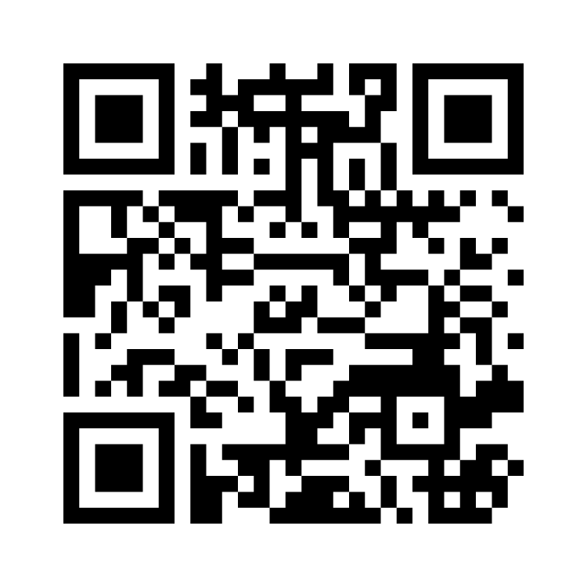
What would you like to debate about this year?
Results
Go to www.menti.com and use the code 5178 2958

Slide 4
The Emerging Debaters session will cover:
What will happen on debate night
How debates are scored
Types of Topics
Matter, Manner and Method
Rebuttal
The Speaking Positions
The Adjudication
What is a short-prep debate?
Questions
Demonstration Debate + Adjudication Assessment

Slide 5
Debaters and Adjudicators can benefit from all the information in this session – adjudicator specific content will be pointed out
Pay attention! Adjudicators will be assessed on their knowledge (and there will be a surprise for debaters at the end of the session…)

Slide 6
Debate Night

Slide 7

Timing of Debates
Junior B (Year 8 and below - novice):
  4 minutes (warning bell at 3 mins)
  Do not speak for more than 4 min 30 sec
Junior A (Year 8 and below - experienced):
  5 minutes (warning bell at 4 mins)
  Do not speak for more than 5 min 30 sec
Do adjudicators simply ‘stop listening’ after 30 seconds over? No.
Going over time: Method issue
Going under time: Matter issue
Notes:
Manner issue: Didn’t select the most relevant points to convince the audience
Matter issue: Didn’t select enough relevant points/examples

Slide 8
Debate Night (Long-Prep)
Arrival Time
5:45pm for a 6:00pm debate (exception for JUN B*)
Please allow time for traffic, bad weather or other delays.
Adjudicators: If you are running late and it is possible and safe, call 0499 482 030.
Check in with Venue Coordinator
Debaters – let your coordinator know when your team has arrived, the coordinator will then help you find your room
Adjudicators – Same as above, plus you will be informed if there has been any changes to your allocation

Slide 9

Preparing the Room
Documents
These may be in the room already or may be provided to the adjudicator by the venue coordinator (usually in a folder or plastic sleeve).
Adjudicators Score Sheet
Room Layout
The students should have the topic of the debate written on the board (large enough for the audience to read).
Student names and speaker numbers should also be written on the board for both teams.
The room should be set out for a debate (see slide 9)
Chairperson’s Speech
Timekeeper’s Sheet

Slide 11
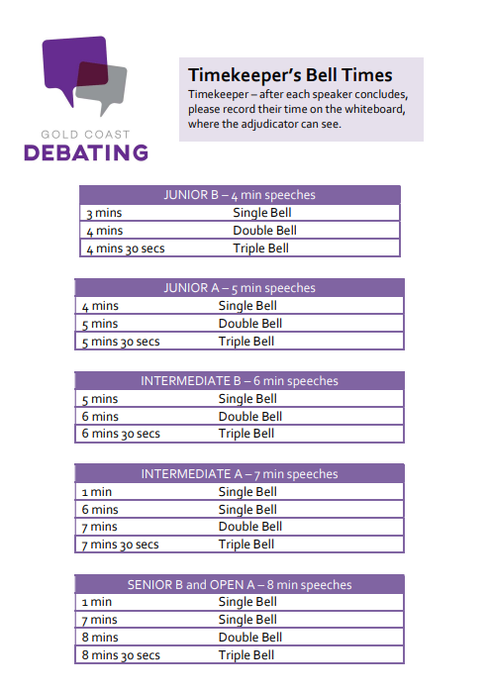

Slide 12
Room Layout
Timekeeper
Chairperson
Affirmative Team
Negative Team
Audience
Adjudicator
Notes:
Especially Junior B, ensure debaters have set up the room properly (people on the correct side, etc). Get them to swap sides if needed.

Slide 13
Ready Check - Debaters
Check
  That both teams are in the room.
  That the doors/windows are closed (noise from outside can distract).
  That the topic and names are written on the board
  That the chairperson has filled out the chairperson sheet (and asked the adjudicator for their name)
  That all speakers and chairperson/debaters have what they need
  That everyone you are waiting on (audience, coaches, etc.) is in the room)
  That the adjudicator is ready to start

Slide 14
Ready Check - Adjudicators
Check
  That you have your scoring sheet and are ready to take notes.
  That the doors/windows are closed (noise from outside can distract).
  Check that both teams are ready.
    If a team is not ready at 6:00pm, use your judgement.
      E.g. If they are waiting for a team member to come back from the bathroom, show compassion. If they just want more time to scribble notes, start the debate anyway.
  You can remind the Chairperson to introduce the next speaker after you give them the signal.
  Tell the Chairperson to begin the debate (quite often a nod to them is enough, they are often eagerly waiting).

Slide 15
Scoring

Slide 16
How are debates judged?
MATTER | What you say
MANNER | How you say it
METHOD | The order in which you say it / the clarity with which you say it
Adjudicators will score each individual debater on their performance in three areas:

Slide 17
The Criteria
Matter
Arguments – strength, plausibility, relevance, engagement with opposition
Rebuttal
Strength of model
Strength of central premise/case line
Anything pertaining to content
Going under time
Manner
Anything pertaining to the speaker’s presentation style and mannerisms – gesture, tone, pace, etc.
Personal presentation*
Teamwork
Sportsmanship
Conduct
Use of appropriately formal language
Method
Structure – both of an entire speech (inc. summaries etc.) and individual points
Existence of a clear case line and/or model
Splits
Definitions
Greetings
Going over time

Slide 18
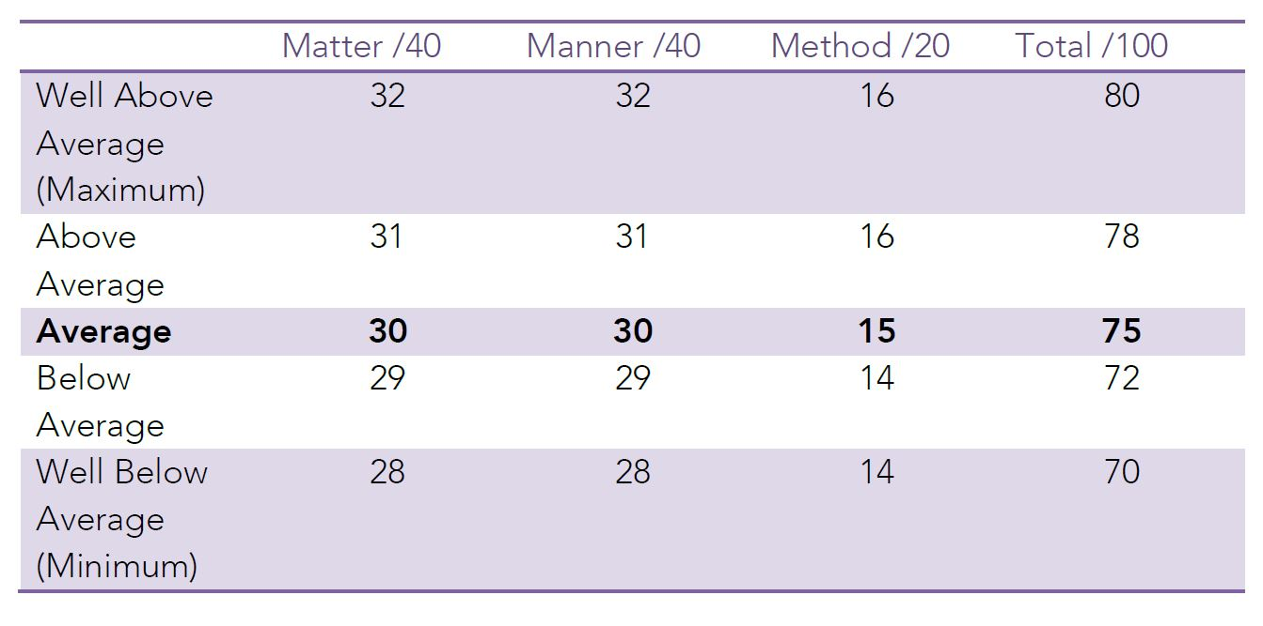
Scoring

Slide 19



Role of the Adjudicator
Evaluate
the debate
Educate
the debaters
Encourage
the debaters

Slide 20
Types of topics

Slide 21
Types of Topics
Statements: Homework is a waste of time / privacy is a privilege not a right
Comparisons: The Winter Olympics are more enjoyable than the Summer Olympics
‘Should’ debates: Public transport should be free. In ‘should’ debates, both the moral and practical issues of the topic need to be covered (Definition of should)

Slide 22
School examinations should be banned - activity
Affirmative
Consider what you would say if you were the affirmative – WHY should they be banned? What problem/s do they pose? Why will banning exams solve these problem/s?
Negative
Consider what you would say if you were the negative – why SHOULDN’T school exams be banned? Why would this be a bad idea?
Discuss
Choose ONE reason to discuss with the person next to you and try to use the PEEL structure to present your reason.

Slide 23
Method

Slide 24
The Criteria
Method
Structure – both of an entire speech (inc. summaries etc.) and individual points
Existence of a clear case line and/or model
Splits
Definitions
Greetings
Going over time
Matter
Arguments – strength, plausibility, relevance, engagement with opposition
Rebuttal
Strength of model
Strength of central premise/case line
Anything pertaining to content
Going under time
Manner
Anything pertaining to the speaker’s presentation style and mannerisms – gesture, tone, pace, etc.
Personal presentation*
Teamwork
Sportsmanship
Conduct
Use of appropriately formal language

Slide 25

Method –
Formal Greetings
ANY speaker MAY start their speech with a formal greeting if they like.
e.g. “Good evening, everyone.” or “Good evening, Chairperson and audience members.”
We encourage inclusive greetings – speakers are no-longer required to use the precise wording “Good evening, Chairperson, ladies and gentlemen.”
NO speaker is REQUIRED to give a formal greeting.
Note: They should never greet the adjudicator specifically – you are just another member of the audience.

Slide 26
Method –
Other Greetings
They might prefer to jump straight into their speech with:
A powerful, relevant quotation
An attention-grabbing fact or statement
A summary of the debate so far (also known as a ‘case comparison’) that presents the team’s case as superior

Slide 27
Definitions
Why do we define the topic?
To provide an accurate dictionary definition of every single word in the topic.
To clarify any potentially unclear terms in the topic and set clear and reasonable parameters for the debate.

Slide 28
Definitions
  1st Affirmative: provides a definition for the debate
  1st Negative: either accepts that definition OR redefines it
What makes a good definition?
Not a definition of each individual word in the topic straight from the dictionary
  you can use a dictionary to help you define technical terms in your topic, but otherwise simply use ‘layman’s terms’ – a simple statement that anybody could come up with and understand
In the intended ‘spirit’ of the debate – what would the average person on the street think this topic is about?
Define terms rather than individual words where appropriate
Negative teams shouldn’t reject for the sake of it – only where they believe it genuinely needs re-defining
Try to avoid ‘definitional debates’: talk of definition shouldn’t progress past second affirmative

Slide 29
Definitions Note
Topic: Summer is better than winter
We define 'summer' as 'the season between spring and autumn comprising in the southern hemisphere as the months of December, January and February', 'is' as 'to be', 'better' as 'more desirable, satisfactory or effective' , 'than' as 'introducing the second element in a comparison', and 'winter' as 'the season between autumn and spring comprising in the second hemisphere as the months of June, July and August'.
We define ‘summer’ simply as the warmest months of the year and, likewise, ‘winter’ as the coldest months of the year. We don’t believe the precise start and end dates of these seasons are relevant in the spirit of this topic. We also think that the most essential term in tonight’s debate is ‘better than’. What does it mean for one season to be ‘better than’ another? We think it means that, when all pros AND cons are weighed up, one season will have more positive aspects overall.

Slide 30
Method - To split or not to split?
Using a split:
A split is an OPTIONAL method of organising points between the first and second speaker. Using a traditional split involves:
  classifying the arguments into two categories
    E.g. society/individuals, social/environmental, social/economic, national/international, long-term/short- term
  giving the 1st speaker the ‘bigger picture’ or simply the most significant / relevant side of the split

Slide 31
Method - To split or not to split?
Not using a split:
An alternative option is to simply order your arguments from strongest --> weakest / most important --> least important, then allocate in order to the 1st and 2nd speaker.
This method allows the adjudicator to hear your most important points first, allowing you to open your case strongly.
Strongest argument | 1st speaker
Second-strongest argument
Third-strongest argument | 2nd speaker
Fourth-strongest argument

Slide 32
Method - Signposting
Signposting helps the adjudicator, the audience, and the opposing team to follow your argument. It is a very simple tool that helps carry the debate, and makes the case stronger and more logical. Signpost example:
  In introduction: “Tonight I have three points. These are….”
  In arguments: “My first point is….” “My next argument is that….” “Finally, we would argue that….”
  In conclusion: “Tonight I presented three points. They were … (1, 2, and 3). All these points clearly prove that (caseline)…

Slide 33
Matter

Slide 34
The Criteria
Arguments – strength, plausibility, relevance, engagement with opposition
Rebuttal
Strength of model
Strength of central premise/case line
Anything pertaining to content
Going under time
Manner
Method
Structure – both of an entire speech (inc. summaries etc.) and individual points
Existence of a clear case line and/or model
Splits
Definitions
Greetings
Going over time
Matter
Anything pertaining to the speaker’s presentation style and mannerisms – gesture, tone, pace, etc.
Personal presentation*
Teamwork
Sportsmanship
Conduct
Use of appropriately formal language

Slide 35
PEEL Structure
P – point – state your point (argument - not just a statement of fact)
E – explain or elaborate (explain your argument and why it is valid)
E – evidence or examples (use evidence or examples to support your arguments e.g. NAPLAN when talking about school examinations)
L – link (link back to the topic! Tell the audience why and how your point goes to prove your argument)

Slide 36
Case Line
A summary statement of your overall argument – DO NOT use a cliche
All team arguments must work to prove this
A winning team will have a strong case line that all team members have worked together to prove
The case line should be tied to the speakers’ points
Avoid too much repetition of the case line – saying it at the beginning and end of your speech is enough

Slide 37
Affirmative Caseline
Topic: Summer is better than winter
We are arguing that summer is better than winter because summer benefits society far more than winter
Friends, sun, sand and sea - that’s sounds like a summer to me

Slide 38
Negative Caseline
Topic: Summer is better than winter
We are arguing that summer is not better than winter because there are dangers to society in summer that simply don't exist in winter
We believe that summer is THE WORST time of year – it’s an ABSOLUTELY INSUFFERABLE, suffocating, horrific, cancer-causing experience that no one could possibly survive, let alone enjoy.

Slide 39
Models and Counter-Models
Affirmative Model | Negative Model
“Stay at home parents should be provided, by the federal government, with support equivalent to the minimum full time wage. This replaces daycare subsidies and other welfare support payments currently available to parents.” | “Rather than paying stay-at-home parents for their work, the negative would maintain support on childcare costs as there is no evidence that children spending more time at home is beneficial.”
The purpose of the model is to give some clarity to how the team suggests we solve the problem posed by the topic.
For example: “Stay at home parents should be paid for their work.”

Slide 40
Matter: What adjudicators should look for
Real examples over hypothetical
  E.g. A large event in a city can have a positive, ongoing impact on tourism. [OK]
  OR
  E.g. The 2000 Olympic games in Sydney resulted in a positive, ongoing increase in tourism. [GOOD]
  If they make a slight mistake in the example that doesn’t change the point, not a huge problem
  E.g. If they say the 2000 Olympic games in Melbourne boosted tourism, the point is the boost in tourism. Not a big deal that they mixed up the city
Recent examples are better
  If a team is discussing a country being invaded, Poland in 1939 is a bad example.
Reward a display of current affairs and general knowledge

Slide 41
Matter: What adjudicators should look for
Quality over quantity
  Two great points is better than four terrible ones
Don’t fill in the blanks
  You might have specific knowledge about the topic, examples given or the arguments themselves. Adjudicate based on what the speaker says, not additional information that you know.
  You can tell them in feedback that they should have brought up that additional information.
In the end, do you buy it? Did that argument provide a reason that made sense.

Slide 42
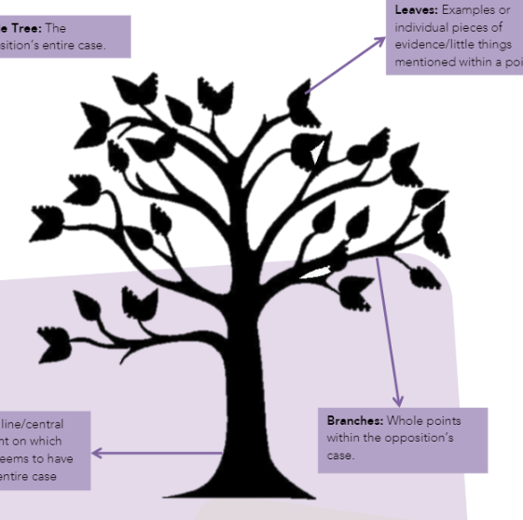
Rebuttal
You must find flaws in the Opposition’s case
It is best to rebut the most important points the Opposition says, especially their central idea/premise (case line) on which their case is based and the points.
DO NOT rebut the examples. Refer to the diagram → attack the trunk and branches, not the leaves

Slide 43
Rebuttal
Structure of a rebuttal:
  Say what was said
  Explain what was wrong/misleading
  Say what is right and give an example (prove your case is better)
  Say how this proves your side of the topic
  Can you rebut a rebuttal? YES, if you think it will strengthen your case

Slide 44
Rebuttal – What makes it strong?
  An example or individual pieces of evidence (leaves): WEAK
  A whole point of the opposition’s case: GOOD
  The central premise of the opposition’s case: GREAT

Slide 45
Speaking Positions

Slide 46
1st Affirmative Speaker

Slide 47

1st Affirmative
Set the scene for the debate (why are we discussing this topic?) – optional
Define key terms and restate the topic in your own words
Give the case line and state the split IF USING ONE
Individual outline – briefly state your points
Give each point/argument with examples – try to have 3 (use PEEL and signpost)
Summary/conclusion (restate your points and your case line)

Slide 48
1st Negative Speaker

Slide 49
1st Negative
Accept (or redefine) the definition
Give your case line
Rebuttal (try to rebut at least one of the 1st Affirmative’s points)
Team outline (including the split if you have one)
Give each point/argument with examples – try to have 3 (use PEEL and signpost)
Summary/conclusion (restate your points and your case line)

Slide 50
2nd Affirmative Speaker

Slide 51

2nd Affirmative
Rebuttal – as many of the 1st Negative’s points as possible
Restate the points your 1st Speaker had and their split (if you have one)
Give your side of the split and how many points you have
Individual outline – briefly state your points
Give each point/argument with examples – try to have 3 (use PEEL and signpost)
Summary/conclusion (restate your points and your case line)

Slide 52
2nd Negative Speaker

Slide 53
2nd Negative
Rebuttal – as many of the 1st AND 2nd AFF speaker’s points as possible
Restate the points your 1st Speaker had and their split (if you have one)
Give your side of the split (IF applicable), how many points you have, and what they are (individual outline – briefly state your points)
Give each point/argument with examples – try to have 3 (use PEEL and signpost)
Summary/conclusion (restate your points and your case line)

Slide 54
3rd Affirmative Speaker

Slide 55
3rd Affirmative
Outline where the debate is at. E.g. “The Opposition has tried to prove that…. Whereas we have argued strongly that..”
Rebuttal (of both 1st and 2nd speakers – in the order of importance). For each argument state:
  What they said
  Why they are wrong
  What is right/Why your team is right
Case Summary of your 1st and 2nd Speakers’ points
Concluding statement: make it persuasive and strong as you finish your team’s case

Slide 56
3rd Negative Speaker

Slide 57
3rd Negative
Outline where the debate is at. E.g. “The Opposition has tried to prove that…. Whereas we have argued strongly that..”
Rebuttal (of ALL AFF points (including rebuttal if possible) – in the order of importance). For each argument state:
  What they said
  Why they are wrong
  What is right/Why your team is right
Case Summary of your 1st and 2nd Speakers’ points
Concluding statement: make it persuasive and strong as you finish your team’s case

Slide 58
Manner

Slide 59
The Criteria
Arguments – strength, plausibility, relevance, engagement with opposition
Rebuttal
Strength of model
Strength of central premise/case line
Anything pertaining to content
Going under time
Manner
Method
Structure – both of an entire speech (inc. summaries etc.) and individual points
Existence of a clear case line and/or model
Splits
Definitions
Greetings
Going over time
Matter
Anything pertaining to the speaker’s presentation style and mannerisms – gesture, tone, pace, etc.
Personal presentation*
Teamwork
Sportsmanship
Conduct
Use of appropriately formal language

Slide 60

Manner
Is it pleasant?
Is it persuasive?
Is it easy to follow?
Different styles are okay.
  One speaker may be quite formal and sound like an expert on the topic – great!
  Another speaker may be more casual and sound like they are having a conversation with the audience – wonderful!
  As long as is it pleasant and persuasive, they are both valid and equally worthy methods.

Slide 61
Manner - Speaking Style
We want to encourage a wider variety of speaking styles.
For those styles to be more engaging and entertaining.
Encourage whatever manner choices prove comfortable and effective for individual speakers (within reason).
Facilitate a more conversational style of debate, with genuine exchange and engagement between sides, rather than prepared speech style.

Slide 62
Manner: conduct
Use of appropriate language
  Effective use of jargon or technical terms that are reasonable understood or given a brief explanation
  Swearing or other offensive language
  Adjudicators CAN and SHOULD interrupt if a speaker is being inappropriate. I use the phrase “Point of order” and then give a warning or tell them to move on. This adds formality to your warning or instruction.
  If a speaker has done the wrong thing and you believe it should be reported, let your venue coordinator know after the debate. They will contact the school involved and the GCD executive.

Slide 63
Manner: things to look out for
pacing and use of pauses
  Not good: speaking too fast/slow, awkward pauses
  Good: pauses for emphasis
volume and tone
  Not good: hard to hear, shouting at the audience, aggressive, monotone
  Good: confident, conversational, persuasive
gesture and movement
  Not good: swaying, overdramatic gestures, ineffective pacing, facing opposition rather than audience – especially during rebuttal
  Good: gesture for emphasis, pacing that is subtle but engaging
eye contact and stance
  Not good: looking down, slouching, leaning against table
  Good: regular eye contact, facing and scanning the audience

Slide 64
Manner: these are counted!
Conduct, Teamwork and Sportsmanship
  Yes, you can penalise a speaker under manner before or after they speak, based on inappropriate conduct at any time during the debate (e.g. talking or making noises during while another debater is speaking.
Personal Presentation
  Only in instances where poor presentation was within the student’s control
    Noisy jewellery, holding paper in front of face, shirt untucked and both shoelaces untied – penalise
    Wearing shorts with blazer (I don’t like the look) – no penalty, that’s the school’s uniform

Slide 65
Manner: do we have to use palm cards?
Students may use palm cards, A4 paper, or anything in between. However, use must be effective.
This means that if they use paper ineffectively – if it distracts, constantly rumples in their hand, is covering their face – then you will still penalise under manner.
Students who do use paper effectively will not be penalised.
They may not read from technological devices.
Students may place a classroom desk (or other available furniture) in front of themselves before their speech if they wish to use such as a lectern.

Slide 66
The Adjudication

Slide 67
What to Write Down - Adjudicators
  This is a different process for everyone. Ultimately, you need to write down whatever information you need to:
  Pick the winning team
  Give valuable feedback
    To the room about why the winning team won
    To each individual speaker and the team about what they did well and what they can do better next time
  Have a record of the basics, in case the VP needs it
    Definition presented, was it accepted/rejected
    A case outline for each side (main points)
    Notes of effective/ineffective rebuttal
    Speech times
    Main reasons the winning team won

Slide 68

No Draws
If the scores are tied once all criteria have been considered, make a change so that one team wins.
There are no draws. You need to award a win to one team.
Go with the team that ultimately won the argument. Who convinced you?

Slide 69
Scoring – tips for adjudicators
Give your Adjudicator’s score sheet to the Venue Coordinator at the end of the night.
You don’t need to tell the scores (teams or individual) to debaters
If you like, when delivering your adjudication (next slide), you can tell them that it was a close debate or even that it was awarded by one point.
If asked for scores, you are empowered to say, “I don’t give out scores.”
Debaters: you are scored based on how you do in comparison to the other speakers in that particular debate. As such, your scores may be wildly different between debates and are not a helpful metric for you to know.

Slide 70

How to deliver an adjudication
A couple of points of general feedback, especially if it applies to multiple debaters, can be given to the room. Then declare the winner and sit. The chairperson will then close the debate.
  Some adjudicators like to announce the winner first, then provide general feedback. This is okay too.
Avoid give individual feedback or single speakers out in front of the whole room
Give at least one (or more) positives to each speaker
Keep reasons for winning general, not specific to one argument or one speaker
Invite speakers to see you for individual feedback
  If you need to go, that’s okay. Just let the teams know that you aren’t able to stay for feedback.
Be mindful of coordinators and lock-up time

Slide 71
What is a short-prep debate?

Slide 72

The Short Prep Debate
Arrive at the venue early
You will be given the topic and time to prepare
  1 h 45 mins for Junior B and Junior A
  1 h 30 mins for Inter B and Inter A
  1 hour for Open B and Open A
Teams of four prepare in a classroom from start to finish
Resources are strictly limited (dictionary/thesaurus, book of quotes, paper and pens)
No technology allowed (including phones and smart watches) PENALTIES/DISQUALIFICATION
Debate begins at 6pm

Slide 73
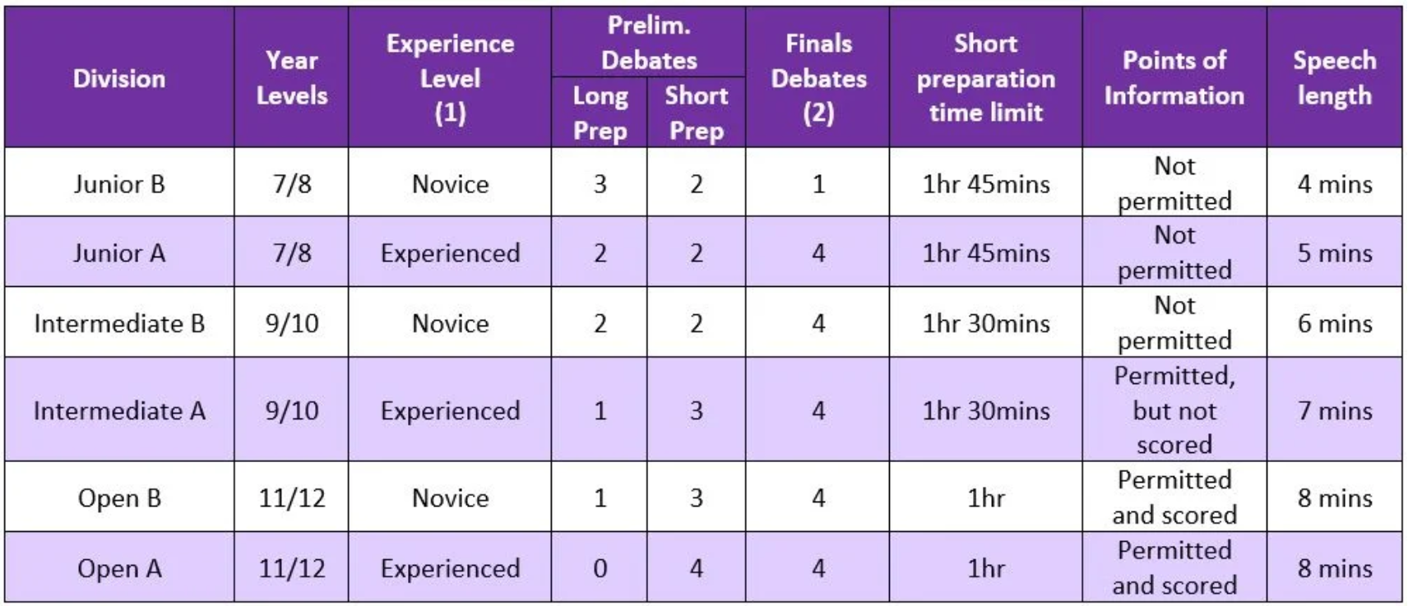

Slide 74
Questions?

Slide 75

Want to help us out?
We are looking to start some subcommittees for GCD. If you are a coach, teacher, adjudicator or alumni and interested in helping get more resources out to our community, please scan the QR code and fill out the form or come talk to one of the executive after the session :)

Slide 76
Kahoot!
https://play.kahoot.it/v2/?quizId=82f0819e-4d4f-4a10-80ff-c680579eb050

Slide 77
GOOD LUCK FOR 2023!
@goldcoastdebating
@goldcoastdebating
Goldcoastdebating.org
For more information visit goldcoastdebating.org

Slide 78
Demonstration Debate

Slide 79
All invited to watch!
If you are an ADJUDICATOR: please come to the front of the room to grab a scoresheet. You will be adjudicating this debate live as part of your assessment.
Our Panel of Adjudicators are Janie-Marie Lynch, Montana MacFarlane and Kate Coombes.
We thank our volunteer debaters from Somerset College for participating in this show debate

