Slide 1





Open
Adjudication
@goldcoastdebating
@goldcoastdebating
Goldcoastdebating.org
GCD catchup 2022

Slide 2



Role of the Adjudicator
Evaluate
the debate
Educate
the debaters
Encourage
the debaters

Slide 3

Debate Night
Arrival Time
  5:45pm for a 6:00pm debate.
  Please allow time for traffic, bad weather or other delays.
  If you are running late and it is possible and safe,
  call 0499 482 030.
Check in with Venue Coordinator
  Let them know you have arrived to adjudicate.
  They will let you know where you are adjudicating and if there have been any changes.

Slide 4

Preparing the Room
Documents
  These may be in the room already or may be provided to you by the venue coordinator (usually in a folder or plastic sleeve).
    Adjudicators Score Sheet, Chairperson’s Speech, Timekeeper’s Sheet

Slide 7
Preparing the Room
Documents
  These may be in the room already or may be provided to you by the venue coordinator (usually in a folder or plastic sleeve).
    Adjudicators Score Sheet, Chairperson’s Speech, Timekeeper’s Sheet
Room Layout
  The students should have the topic of the debate written on the board (large enough for the audience to read).
  Student names and speaker numbers should also be written on the board for both teams.
  The room should be set out for a debate (see next slide).

Slide 8
Room Layout
Timekeeper
Chairperson
Affirmative Team
Negative Team
Audience
Adjudicator
Notes:
Especially Junior B, ensure debaters have set up the room properly (people on the correct side, etc). Get them to swap sides if needed.

Slide 9
Ready Check
Check
  That you have your scoring sheet and are ready to take notes.
  That the doors/windows are closed (noise from outside can distract).
  Check that both teams are ready.
    If a team is not ready at 6:00pm, use your judgement.
      E.g. If they are waiting for a team member to come back from the bathroom, show compassion. If they just want more time to scribble notes, start the debate anyway.
  You can remind the Chairperson to introduce the next speaker after you give them the signal.
  Tell the Chairperson to begin the debate (quite often a nod to them is enough, they are often eagerly waiting).

Slide 10
What to Write Down
  This is a different process for everyone. Ultimately, you need to write down whatever information you need to:
  Pick the winning team
  Give valuable feedback
    To the room about why the winning team won
    To each individual speaker and the team about what they did well and what they can do better next time
  Have a record of the basics, in case the VP needs it
    Definition presented, was it accepted/rejected
    A case outline for each side (main points)
    Notes of effective/ineffective rebuttal
    Speech times
    Main reasons the winning team won

Slide 11
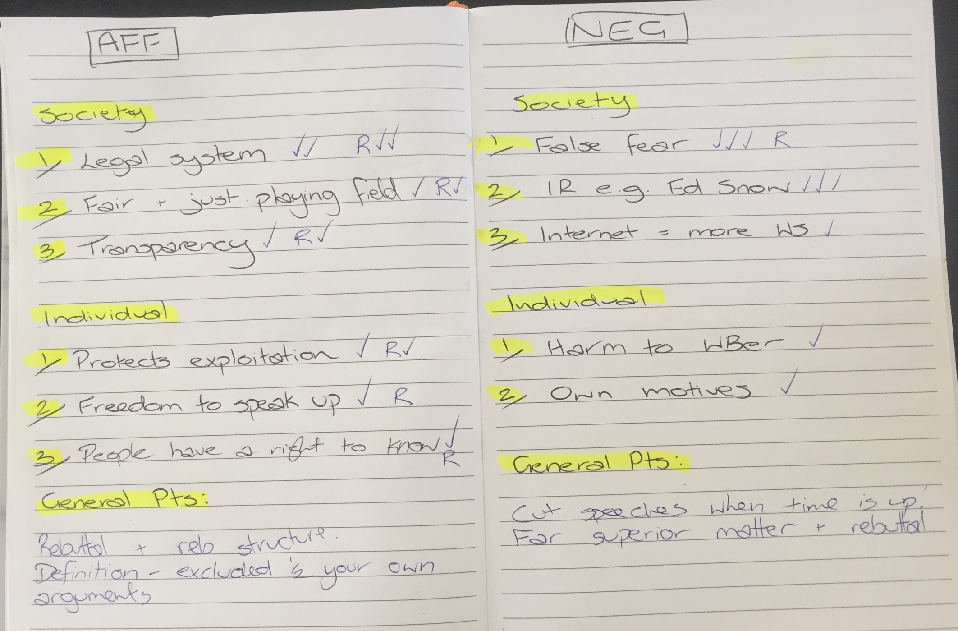

Slide 12
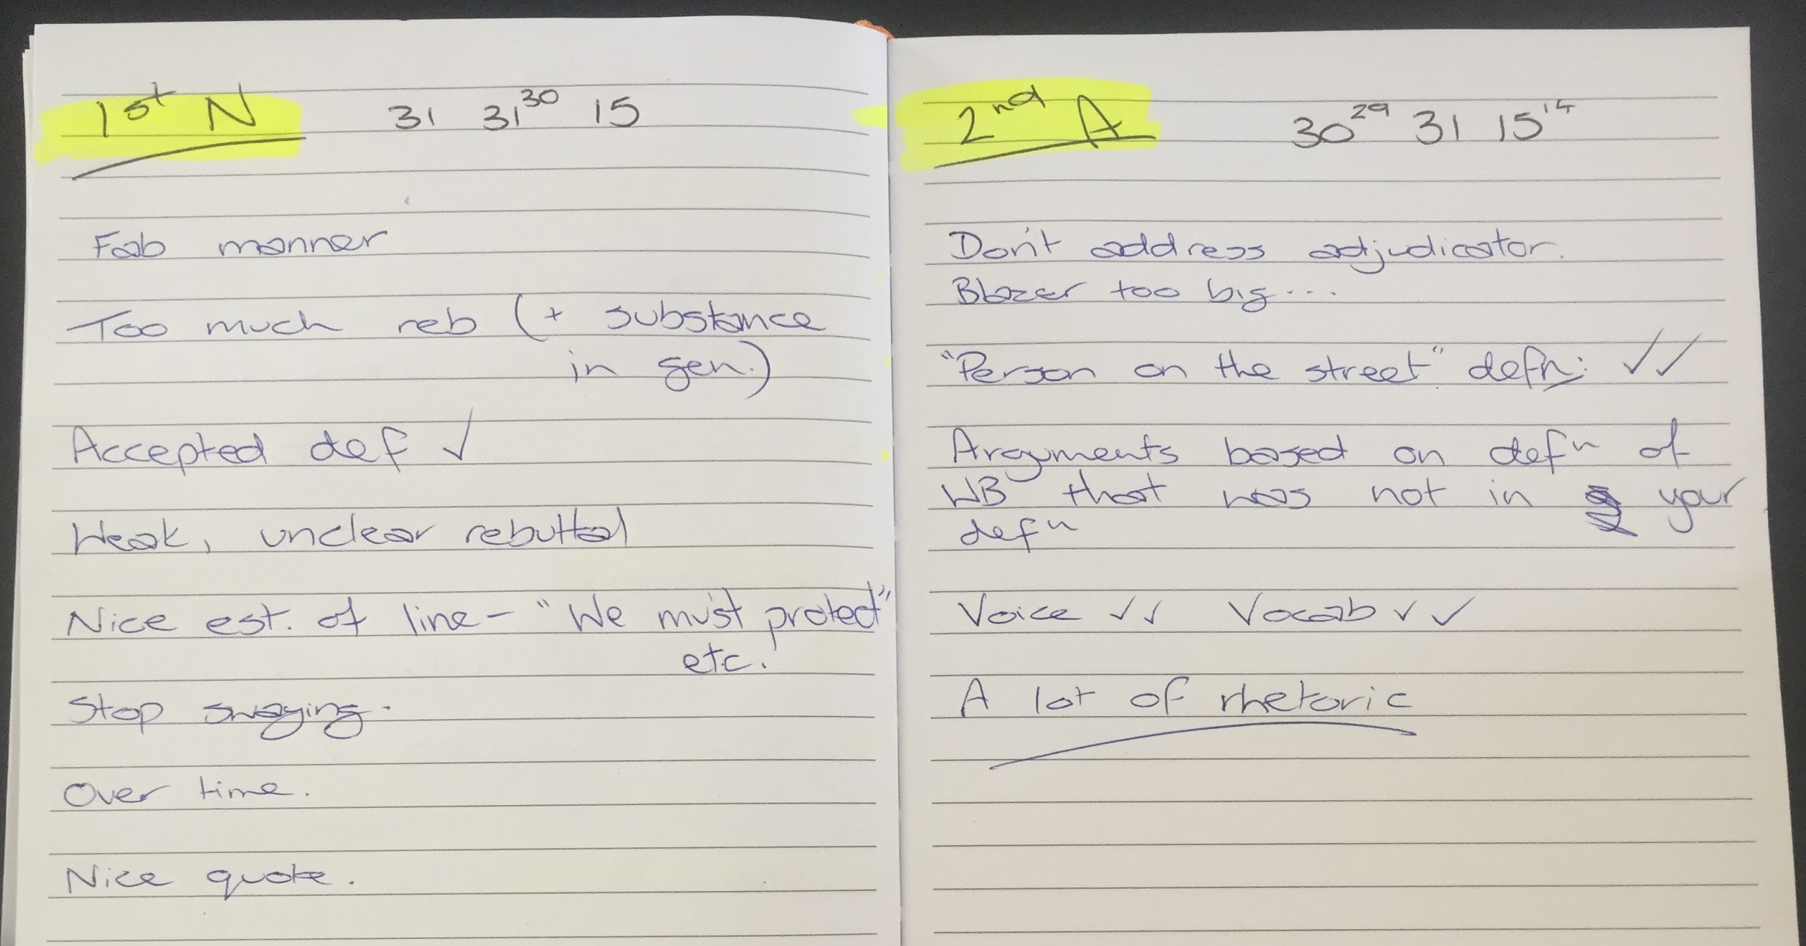

Slide 13
How are debates judged?
MATTER | What you say
MANNER | How you say it
METHOD | The order in which you say it / the clarity with which you say it
Adjudicators will score each individual debater on their performance in three areas:

Slide 14
The Criteria
Matter
Arguments – strength, plausibility, relevance, engagement with opposition
Rebuttal
Strength of model
Strength of central premise/case line
Anything pertaining to content
Going under time
Manner
Anything pertaining to the speaker’s presentation style and mannerisms – gesture, tone, pace, etc.
Personal presentation
Teamwork
Sportsmanship
Conduct
Use of appropriately formal language
Method
Structure – both of an entire speech (inc. summaries etc.) and individual points
Existence of a clear case line and/or model
Greetings
Going over time
Splits
Definitions
Signposting

Slide 15
METHOD

Slide 16

Method – Greetings
Students may start their speech with:
An attention-grabbing fact or statement
A powerful, relevant quotation
A summary of the debate so far (also known as a ‘case comparison’) that presents the team’s case as superior
A formal greeting

Slide 17
Method – Approach to different topics
Statements: Benchmark
  Homework is a waste of time.
  Privacy is a privilege not a right.
Comparisons:
  The Winter Olympics are more enjoyable than the Summer Olympics.
‘Should’ debates: Model
  Public transport should be free.
  In ‘should’ debates, both the moral and practical issues of the topic need to be covered.

Slide 18
Method - Definitions
Why do we define the topic?
To provide an accurate dictionary definition of every single word in the topic.
To clarify any potentially unclear terms in the topic and set clear and reasonable parameters for the debate.

Slide 19
Method - Definitions
  1st Affirmative: provides a definition for the debate
  1st Negative: either accepts that definition OR redefines it
What makes a good definition?
Not a definition of each individual word in the topic straight from the dictionary
  you can use a dictionary to help you define technical terms in your topic, but otherwise simply use ‘layman’s terms’ – a simple statement that anybody could come up with and understand
In the intended ‘spirit’ of the debate – what would the average person on the street think this topic is about?
Define terms rather than individual words where appropriate
Negative teams shouldn’t reject for the sake of it – only where they believe it genuinely needs re-defining
Try to avoid ‘definitional debates’: talk of definition shouldn’t progress past second affirmative

Slide 20
Definitions Note
Topic: Summer is better than winter
We define 'summer' as 'the season between spring and autumn comprising in the southern hemisphere as the months of December, January and February', 'is' as 'to be', 'better' as 'more desirable, satisfactory or effective' , 'than' as 'introducing the second element in a comparison', and 'winter' as 'the season between autumn and spring comprising in the second hemisphere as the months of June, July and August'.
We define ‘summer’ simply as the warmest months of the year and, likewise, ‘winter’ as the coldest months of the year. We don’t believe the precise start and end dates of these seasons are relevant in the spirit of this topic. We also think that the most essential term in tonight’s debate is ‘better than’. What does it mean for one season to be ‘better than’ another? We think it means that, when all pros AND cons are weighed up, one season will have more positive aspects overall.

Slide 21
Method - Signposting
Signposting helps the adjudicator, the audience, and the opposing team to follow your argument. It is a very simple tool that helps carry the debate, and makes the case stronger and more logical. Signpost example:
  In introduction: “Tonight I have three points. These are….”
  In arguments: “My first point is….” “My next argument is that….” “Finally, we would argue that….”
  In conclusion: “Tonight I presented three points. They were … (1, 2, and 3). All these points clearly prove that (caseline)…

Slide 22
Method - To split or not to split?
Using a split:
A split is an OPTIONAL method of organising points between the first and second speaker. Using a traditional split involves:
  classifying the arguments into two categories
    E.g. society/individuals, social/environmental, social/economic, national/international, long-term/short- term
  giving the 1st speaker the ‘bigger picture’ or simply the most significant / relevant side of the split

Slide 23
Method - To split or not to split?
Not using a split:
An alternative option is to simply order your arguments from strongest --> weakest / most important --> least important, then allocate in order to the 1st and 2nd speaker.
This method allows the adjudicator to hear your most important points first, allowing you to open your case strongly.
Strongest argument | 1st speaker
Second-strongest argument
Third-strongest argument | 2nd speaker
Fourth-strongest argument

Slide 24
Models and Counter-Models
The purpose of the model is to give some clarity to how the team suggests we solve the problem posed by the topic.
For example: “Stay at home parents should be paid for their work.”
Affirmative Model | Negative Model
“Stay at home parents should be provided, by the federal government, with support equivalent to the minimum full time wage. This replaces daycare subsidies and other welfare support payments currently available to parents.” | “Rather than paying stay-at-home parents for their work, the negative would maintain support on childcare costs as there is no evidence that children spending more time at home is beneficial.”

Slide 25
Timing of Debates
Intermediate A
  7 minutes - POI bells at 1 minute and 6 minutes
  Double bell at 7 minutes to indicate time
  Triple bell at 7 minutes 30 seconds for overtime
Open B and A
  8 minutes - POI bells at 1 minute and 7 minutes
  Double bell at 8 minutes to indicate time
  Triple bell at 8 minutes 30 seconds for overtime
Do adjudicators simply ‘stop listening’ after 30 seconds over? No.
Going over time: Manner issue - Going under time: Matter issue
Notes:
Manner issue: Didn’t select the most relevant points to convince the audience
Matter issue: Didn’t select enough relevant points/examples

Slide 26
MANNER

Slide 27
Manner
Is it pleasant?
Is it persuasive?
Is it easy to follow?
Different styles are okay.
  One speaker may be quite formal and sound like an expert on the topic – great!
  Another speaker may be more casual and sound like they are having a conversation with the audience – wonderful!
  As long as is it pleasant and persuasive, they are both valid and equally worthy methods.

Slide 28
Manner - Speaking Style
We want to encourage a wider variety of speaking styles.
For those styles to be more engaging and entertaining.
Encourage whatever manner choices prove comfortable and effective for individual speakers (within reason).
Facilitate a more conversational style of debate, with genuine exchange and engagement between sides, rather than prepared speech style.

Slide 29
Manner
You should consider:
pacing and use of pauses (speaking too fast/slow, awkward pauses or pauses for emphasis)
volume and tone (hard to hear, shouting at the audience, good conversational, aggressive)
gesture and movement (swaying, gesture for emphasis, facing opposition rather than audience – especially during rebuttal)
eye contact and stance (looking down, scanning audience, slouching, leaning against table)

Slide 30
Manner
Conduct, Teamwork and Sportsmanship
  Yes, you can penalise a speaker under manner before or after they speak, based on inappropriate conduct at any time during the debate (e.g. talking or making noises during while another debater is speaking.
Personal Presentation
  Only in instances where poor presentation was within the student’s control
    Noisy jewellery, holding paper in front of face, shirt untucked and both shoelaces untied – penalise
    Wearing shorts with blazer (I don’t like the look) – no penalty, that’s the school’s uniform

Slide 31
Manner
Use of appropriate language
  Effective use of jargon or technical terms that are reasonable understood or given a brief explanation
  Swearing or other offensive language
  You CAN and SHOULD interrupt if a speaker is being inappropriate. I use the phrase “Point of order” and then give a warning or tell them to move on. This adds formality to your warning or instruction.
  If a speaker has done the wrong thing and you believe it should be reported, let your venue coordinator know after the debate. They will contact the school involved and the GCD executive.

Slide 32
Manner - Palm Cards?
Students may use palm cards, A4 paper, or anything in between. However, use must be effective.
This means that if they use paper ineffectively – if it distracts, constantly rumples in their hand, is covering their face – then you will still penalise under manner.
Students who do use paper effectively will not be penalised.
They may not read from technological devices.
Students may place a classroom desk (or other available furniture) in front of themselves before their speech if they wish to use such as a lectern.

Slide 33
MATTER

Slide 34
Matter – Hard and Soft Lines
How strongly does a team support or refute the case?
  E.g. Topic: “Generation Z are lazy”
  Soft negative: Generation Z are not lazy. They work differently, in different times and methods.
  Hard negative: Generation Z are incredibly hard-working, more than previous generations.
The soft line is not always weaker. It can be more effective in arguing the topic. Consider the spirit of the debate and whether it is being addressed.

Slide 35
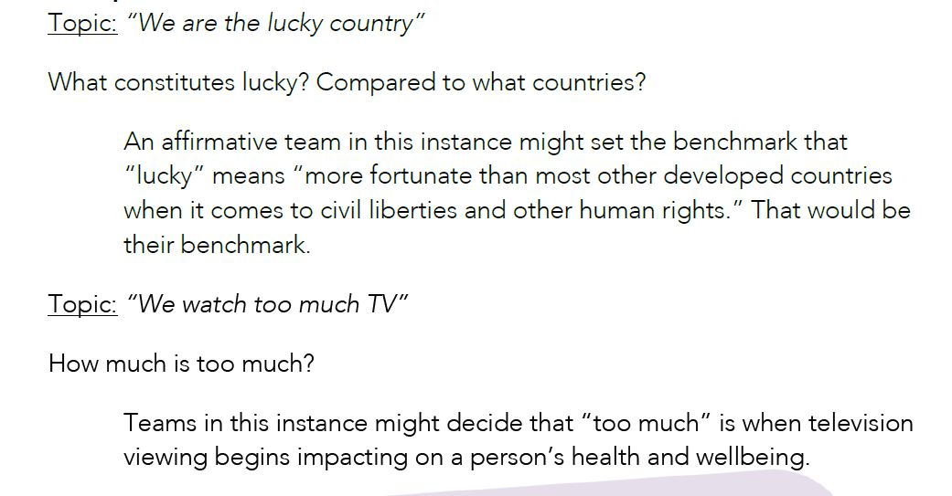
Matter – Benchmarks
Help make debates and cases clearer
A set of metrics, chosen by each team
Usually given in statement debates
Often clarified by the definition.

Slide 36
Matter - Examples
Real examples over hypothetical
  E.g. A large event in a city can have a positive, ongoing impact on tourism. [MEH]
  OR
  E.g. The 2000 Olympic games in Sydney resulted in a positive, ongoing increase in tourism. [GOOD]
  If they make a slight mistake in the example that doesn’t change the point, not a huge problem
  E.g. If they say the 2000 Olympic games in Melbourne boosted tourism, the point is the boost in tourism. Not a big deal that they mixed up the city
Recent examples are better
  If a team is discussing a country being invaded, Poland in 1939 is a bad example.
Reward a display of current affairs and general knowledge

Slide 37
Matter
Quality over quantity
  Two great points is better than four terrible ones
Don’t fill in the blanks
  You might have specific knowledge about the topic, examples given or the arguments themselves. Adjudicate based on what the speaker says, not additional information that you know.
  You can tell them in feedback that they should have brought up that additional information.
In the end, do you buy it? Did that argument provide a reason that made sense.

Slide 38
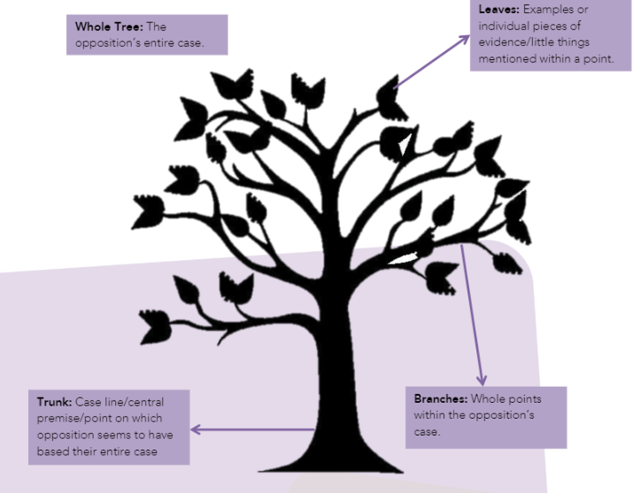
Matter - Rebuttal
Structure of a rebuttal:
  Say what was said
  Explain what was wrong/misleading
  Say what is right and give an example (prove your case is better)
  Say how this proves the side of the topic
What are they rebutting:
  An example or individual pieces of evidence (leaves): WEAK
  A whole point of the opposition’s case: GOOD
  The central premise of the opposition’s case: GREAT
  Can you rebut a rebuttal?
  YES, if it will strengthen the case

Slide 39
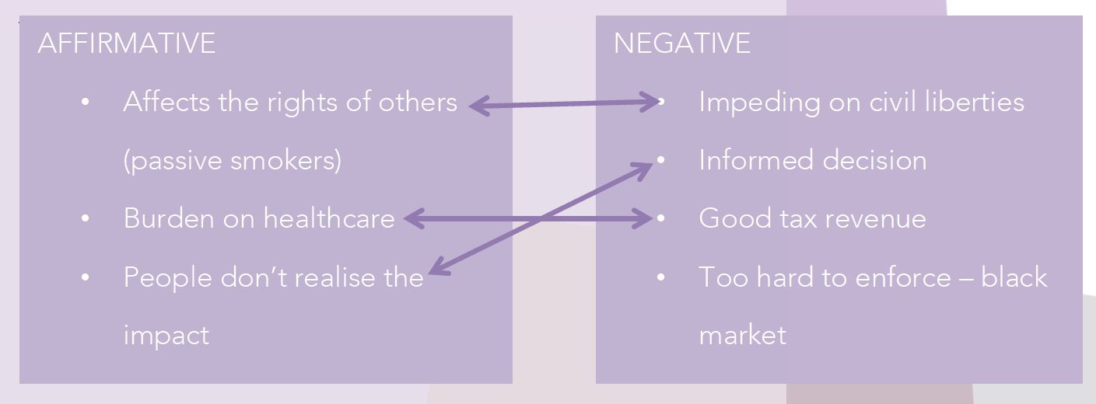
Rebuttal - Matter
There are higher expectations placed on debaters who aren’t juniors
The substantive (arguments) and rebuttal should be less segregated and more entwined – there should be constant referencing to arguments in rebuttal and vice-versa
You may see:
  case comparisons
  comparative rebuttal

Slide 40
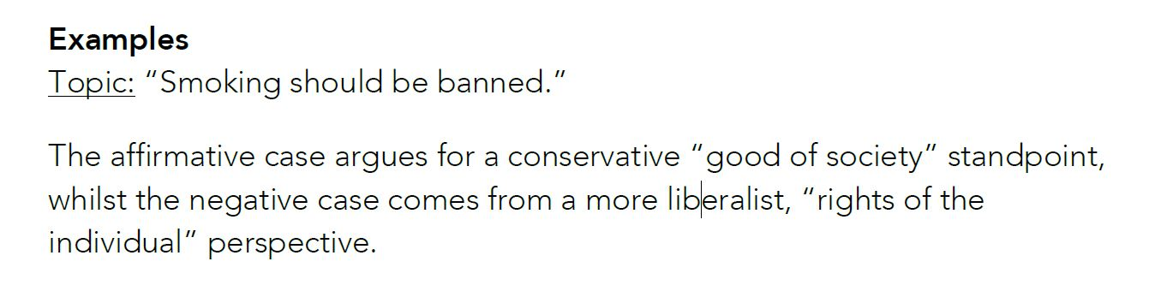
Matter – Fundamental Clash
Refers to the underlying, political or ideological clash in the debate
A team that identifies there can take a well-rounded and sophisticated approach to the debate, as well as draw similarities to other examples/situations

Slide 41
Points of Information
A Point of Information (POI) is a questions asked of a speaker during their speech
In Intermediate A and above, each speaker in the debate is expected to accept two POIs
Each speaker is expected to ask two POIs throughout the entire debate
POIs cannot be offered in the first or last minute of a speech – there will be a bell one minute into the speech, and when there is one minute remaining to assist with this

Slide 42
Points of Information
The purpose of a POI is to undercut the point the opposition is currently making
If can be used to force the opposition to respond to a difficult question on the spot
As an adjudicator, decide which was better: the question or the answer?
Did the question take more away from the speaker’s case than their response added?

Slide 43
Points of Information
The person asking the POI will stand and ask the speaker, “POI?”
The speaker should respond politely with “no, thank you” or “yes” or “yes, please”
  Any rude response or simple waving the speaker down impacts their Manner
The response should be directed to the audience, not the asker (Manner)
Once asked, the asker should sit down immediately (they should never argue back)
  It’s okay for you to wave them down if they forget
Too many POIs asked in succession is badgering

Slide 44
POI Examples
Good | Not Good
“You mentioned the decline in Indigenous languages. Can you explain the connection between Indigenous languages and the commodification of Indigenous culture?” POIs should catch the speaker off-guard by pointing out something that, as evidenced by what they’re saying, they have missed or are not prepared to respond to. If the question does so, the POI asker has been successful. | “Where did you get that information?” “[Insert rebuttal here] How do you respond?” Similar to rebuttal, debaters shouldn’t ask anything that nitpicks an insignificant details of what the speaker is saying. If the question helps the speaker reinforce a point or emphasise their case, then the POI asker has not been successful.

Slide 45
Interrupting POIs
As the adjudicator you can (and sometimes should) interrupt POIs
When | What to say
Offered in the first or late minute. | “Out of order, time.”
The asker forgets their question. | “It’s okay, have a seat.”
The asker keeps talking about their own point. | “Out of order, ask a single question.”
The speaker gets too flustered/freezes up. | “It’s okay, move on.”
Badgering. | “Out of order, badgering.”
Cross floor dialogue. | “Out of order, no cross floor debate.”
Personal attacks/inappropriate. | “I’ll ask the speaker to move on.”

Slide 46
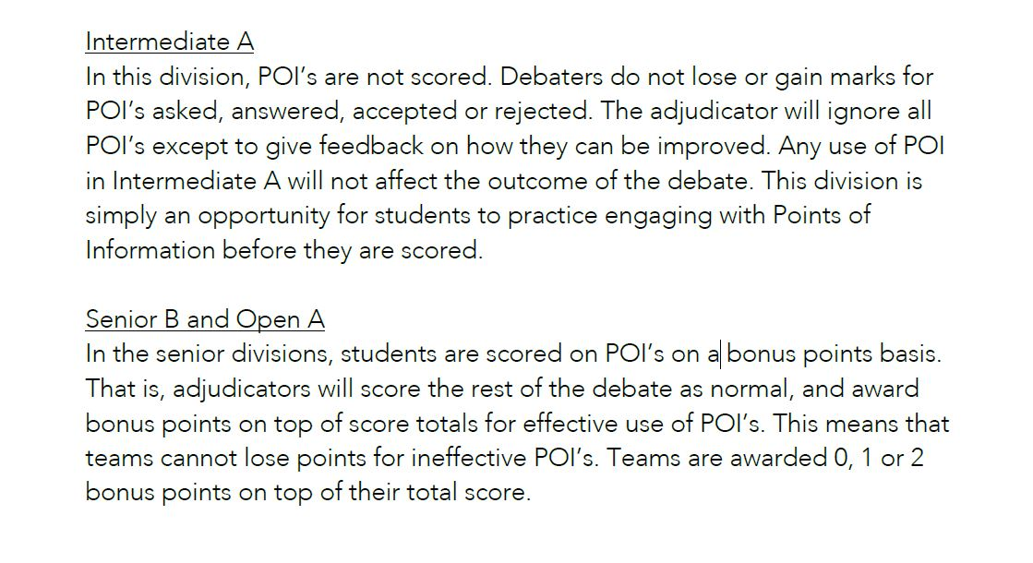
Scoring POIs

Slide 47
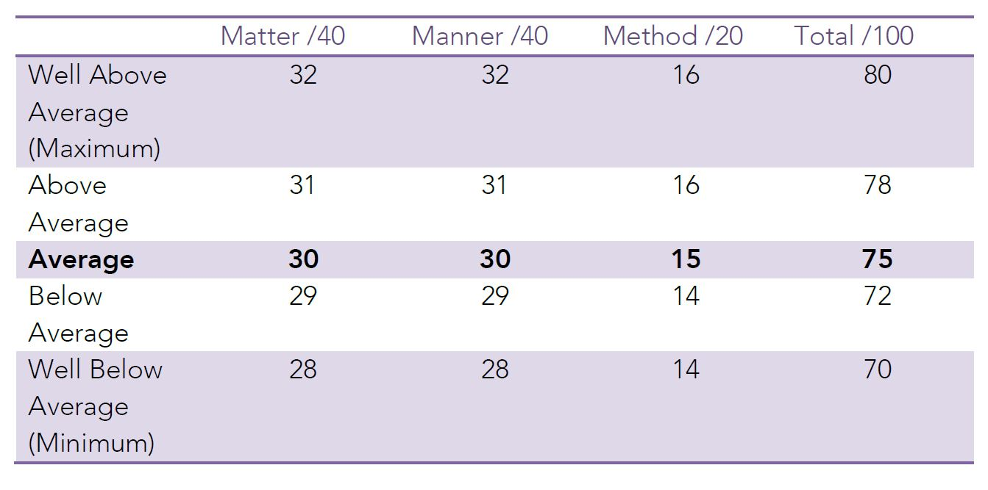
Scoring

Slide 48
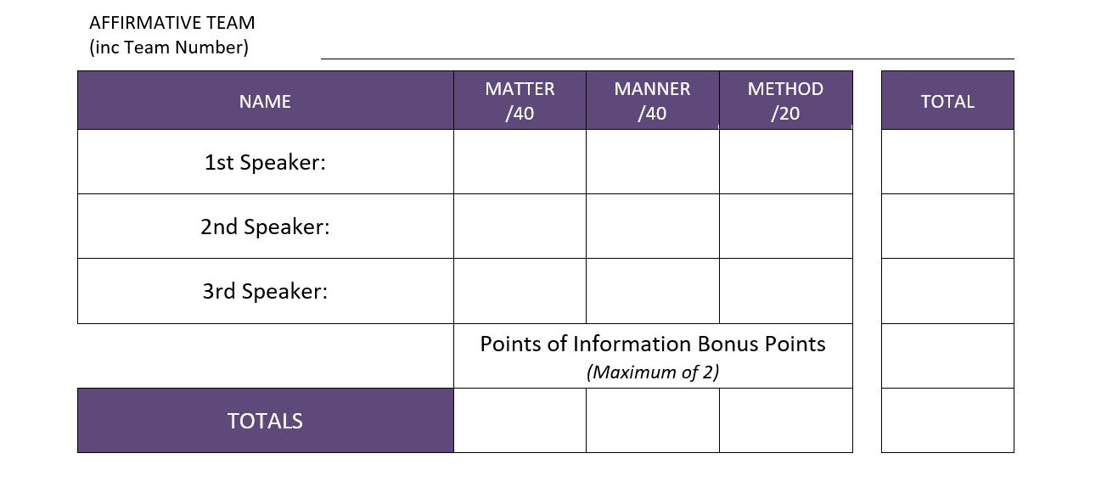
Scoring POIs

Slide 49
No Draws
If the scores are tied once all criteria have been considered, make a change so that one team wins.
There are no draws. You need to award a win to one team.
Go with the team that ultimately won the argument. Who convinced you?

Slide 50
Delivering your adjudication
A couple of points of general feedback, especially if it applies to multiple debaters, can be given to the room. Then declare the winner and sit. The chairperson will then close the debate.
Avoid give individual feedback or single speakers out in front of the whole room
Give at least one (or more) positives to each speaker
Keep reasons for winning general, not specific to one argument or one speaker
Invite speakers to see you for individual feedback
  If you need to go, that’s okay. Just let the teams know that you aren’t able to stay for feedback.
Be mindful of coordinators and lock-up time

Slide 51
Scoring – logistics
Give your Adjudicator’s Score Sheet to the Venue Coordinator at the end of the night.
You don’t need to tell the scores (teams or individual) to debaters
If you like, when delivering your adjudication (next slide), you can tell them that it was a close debate or even that it was awarded by one point.
If asked for scores, you are empowered to say, “I don’t give out scores.”
If you want to give scores, please explain that are used to compare speakers in that debate, not different debates. I.e. A high score in one debate doesn’t mean it was better than a debate that scored lower.

Slide 52
Questions?

Slide 53

GOOD LUCK FOR 2025!
@goldcoastdebating
@goldcoastdebating
Goldcoastdebating.org
If you are in year 11 or 12 – stay here for junior adjudication
For more information visit goldcoastdebating.org

