Slide 1





Intermediate & Open Debating
@goldcoastdebating
@goldcoastdebating
Goldcoastdebating.org
GCD Summer school 2022

Slide 2
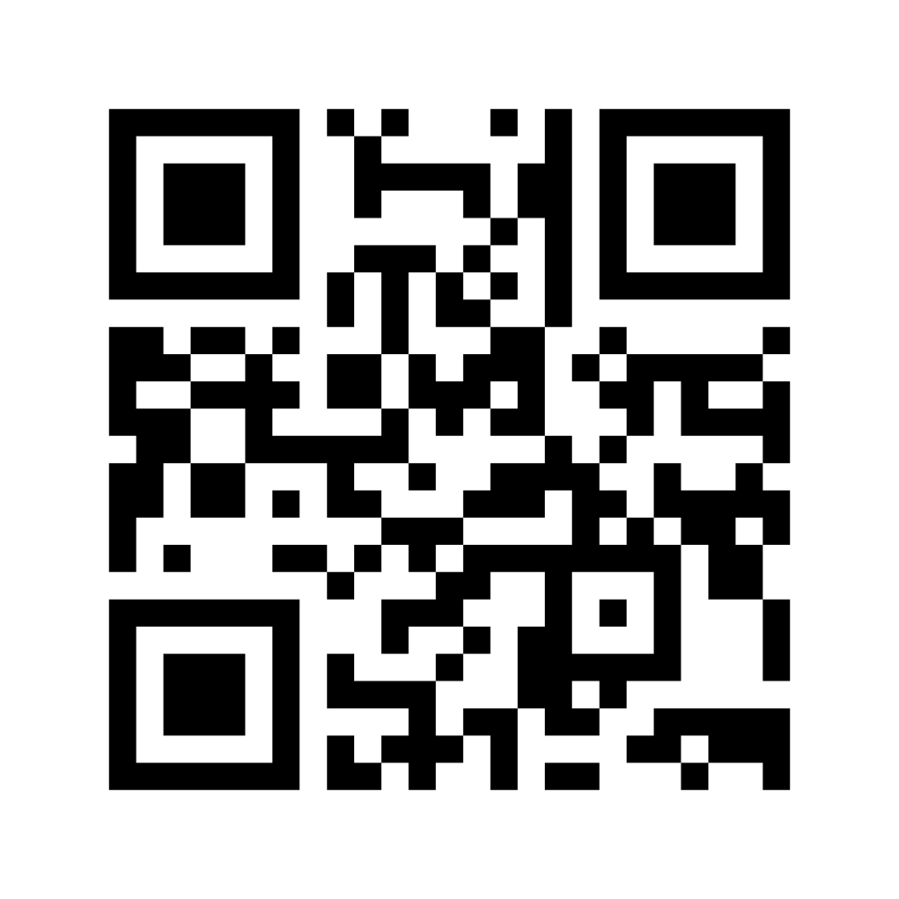
Let’s get to know you!
Results

Slide 3
Today’s Course: Fundamental Differences
higher expectations - general knowledge
greater focus on the debate itself
higher expectations – rebuttal
more advanced techniques
points of information (POI)
comparative rebuttal
models
hard/soft lines
benchmarks
fundamental clashes

Slide 4
Higher Expectations- General Knowledge
At the senior level, students should also be gathering their information from a range of unbiased sources and presenting well-rounded perspectives on current affairs.
Critical, higher-order thinking should be starting to come to the fore in the higher divisions.

Slide 5
Greater Focus on the Debate Itself
By Intermediate A, teams are expected to have a grasp on manner and method.
That doesn't mean that these criteria are no longer relevant, but simply that as much focus as possible should be on the arguments.
Timing and manner become less important than who won the debate itself.

Slide 6
Higher Expectations – Rebuttal
In the senior divisions, students should be gaining proficiency in rebuttal strategies, structure and strength. There should be a greater percentage of speeches being spent on rebuttal, especially for third speakers (over half)
More advanced techniques, such as comparative rebuttal, should be being utilised.

Slide 7
Changes in 2019/2020
(Manner and Method)
The aim of these changes was to:
Encourage a wider variety of speaking styles
For those styles to be more engaging and entertaining
Encourage whatever manner choices prove comfortable and effective for individual speakers (within reason)
Facilitate a more conversational style of debate, with genuine exchange and engagement between sides, rather than prepared speech style.
Notes:
x

Slide 8
Changes in 2019/2020
(Manner and Method)
To that end:
Students may now use palm cards, A4 paper, or anything in between. However, use must be effective.
They may not read from technological devices.
Students may place a classroom desk (or other available furniture) in front of themselves before their speech if they wish to use such as a lectern.

Slide 9
Changes in 2019/2020
(Manner and Method)
NOTES:
Whilst we are technically open to the use of paper or palm cards across all divisions/year levels, whichever method students choose must come across effectively.
This means that if they use paper ineffectively – if it distracts, constantly rumples in their hand, is covering their face – then you will still penalise under manner.
For the above reason, I would strongly encourage debaters in the Junior B – Intermediate B divisions to stick with palm cards for now. The style of debate we see in those divisions is not such that requires the larger paper to map out ideas. Students in these divisions who do use paper effectively still will not be penalised, but we would suggest that such is unnecessarily difficult for younger students.
Notes:
x

Slide 10
Changes in 2019/2020
Economy of words
Aspects of a speech that aren’t actual content (i.e. summaries, greetings, etc.) should use as few words as possible:
“Before I continue my teams case, I’d like to point out a number of contentions within the opposition’s arguments.”
“First, several points in rebuttal:”
“The opposition’s first speaker stated…”
“At First, we heard…”
First speaker’s first point = 1.1, etc.
E.g.
“At 1.1, we heard…” instead of, “The opposition’s first speaker said in their first point…”
Re-stating the topic at every speaker is unnecessary.
Formal greetings are unnecessary except at first AFF.
Summaries should use one or two words to signpost a point, e.g.:
“Our First spoke about job security and personal finances. I will…”

Slide 11
Other Advanced Techniques

Slide 12
Fundamental Clash
Often refers to an underlying, political or ideological-based clash in the debate
Identifying these can help teams take a more well-rounded and sophisticated approach to the debate, as well as draw similarities to other examples/situations
Example
  Topic: Smoking should be banned
  The affirmative case argues for a conservative "good of society" standpoint, whilst the negative case comes from a more liberalist, "rights of the individual" perspective

Slide 13
Types of Rebuttal
Shopping List Rebuttal
Where the speaker takes individual points presented by the opposition and rebuts them individually
Comparative Rebuttal
Speakers take a point that the opposition has presented and use one of your points to directly refute it – hard but impressive
Whole Case Rebuttal
Where the takes their opposition’s case line or otherwise core argument and refutes it. Very powerful.

Slide 14
Models and Counter-Models
Appearing mostly in “should” debates – which advocate change – teams need to outline what change they are advocating. How will the change be carried out?
  What are the details of the change? Its extent?
“University education should be free”
  For who? Only those who qualify?
  Who would pay for it? The government?
  How would this change be carried out? From when?
Teams don’t need to go into too much detail, just enough so we know exactly what it is that they’re trying to say should happen, so we don’t waste time debating over that instead of the real issues.
A model should be introduced by the first speaker after or as a part of their definition. If a team is advocating for a change then they must have a model or counter model.
Negative teams can have counter models (that can be the status quo)

Slide 15
Hard and Soft Lines
Usually come into play for negative teams.
They pertain to how strongly a negative team refutes the affirmative’s case.
Example
Topic: “Generation Z are lazy”
Soft negative: Generation Z are not lazy they just work differently, on
computers etc.
Hard negative: Generation Z are incredibly hard-working and possess
an impeccable work ethic in all facets of their rich lives.
The soft line is not always weaker. It usually is, but sometimes, as perhaps in this instance, it can be more effective.

Slide 16
Benchmarks
Help make debates and cases clearer
Included in the definition
Benchmarks should be used in “is” or “are” type debates – for example:
“We are the lucky country”
What constitutes lucky? Compared to what countries?
“We watch too much TV”
How much is too much?
“Advertising is harmful.”
What is this debate going to consider constitutes harmful?

Slide 17
Points of Information (POIs)
A question asked of a speaker during their speech
Each speaker in the debate is obligated to accept two POIs, and offer two POIs throughout the entire debate (not per speaker)
POIs cannot be offered in the first or last minute of a speech – there will be a bell 1 min into the speech and when there is 1 min left to go to assist with this
Purpose: to undercut the point the opposition is currently making, or to force the opposition to respond to a difficult question immediately

Slide 18
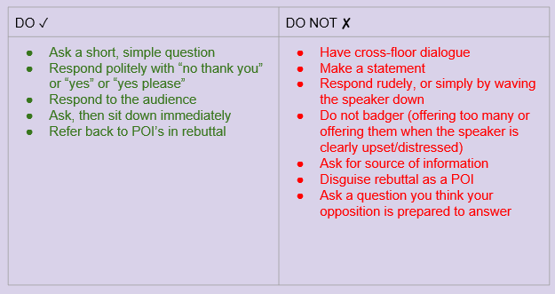
POI Do’s and Don’ts

Slide 19
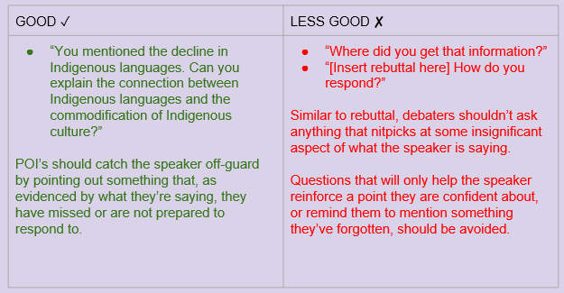
POI Examples

Slide 20
Models and Counter-Models
Topic: Boomers should do more to help younger generations.

Slide 21
GOOD LUCK FOR 2022!
@goldcoastdebating
@goldcoastdebating
Goldcoastdebating.org
If you are an adjudicator stay here for Inter/Open adjudication
For more information visit goldcoastdebating.org

